Slide 1



GIT ASSIGNMENT
Presented By : Rohit Raj

Slide 2
AGENDA
Introduction to GIT
About GitHub
Git Cheat Sheet
Creating Empty Repository
Basic Git workflow
GIT Worktree
GitHub link
Conclusion

Slide 3
WHAT IS GIT ?
Git is software for tracking changes in any set of files, usually used for coordinating work among programmers collaboratively developing source code during software development. Its goals include speed, data integrity, and support for distributed, non-linear workflows (thousands of parallel branches running on different systems.

Slide 4

What is GitHub?
What is GitHub?
GitHub is a code hosting platform for collaboration and version control.
GitHub helps us and others to work together on projects.
GitHub essentials are:
Repositories
Branches
Commits
Pull Requests
Git (the version control software GitHub is built on)

Slide 5
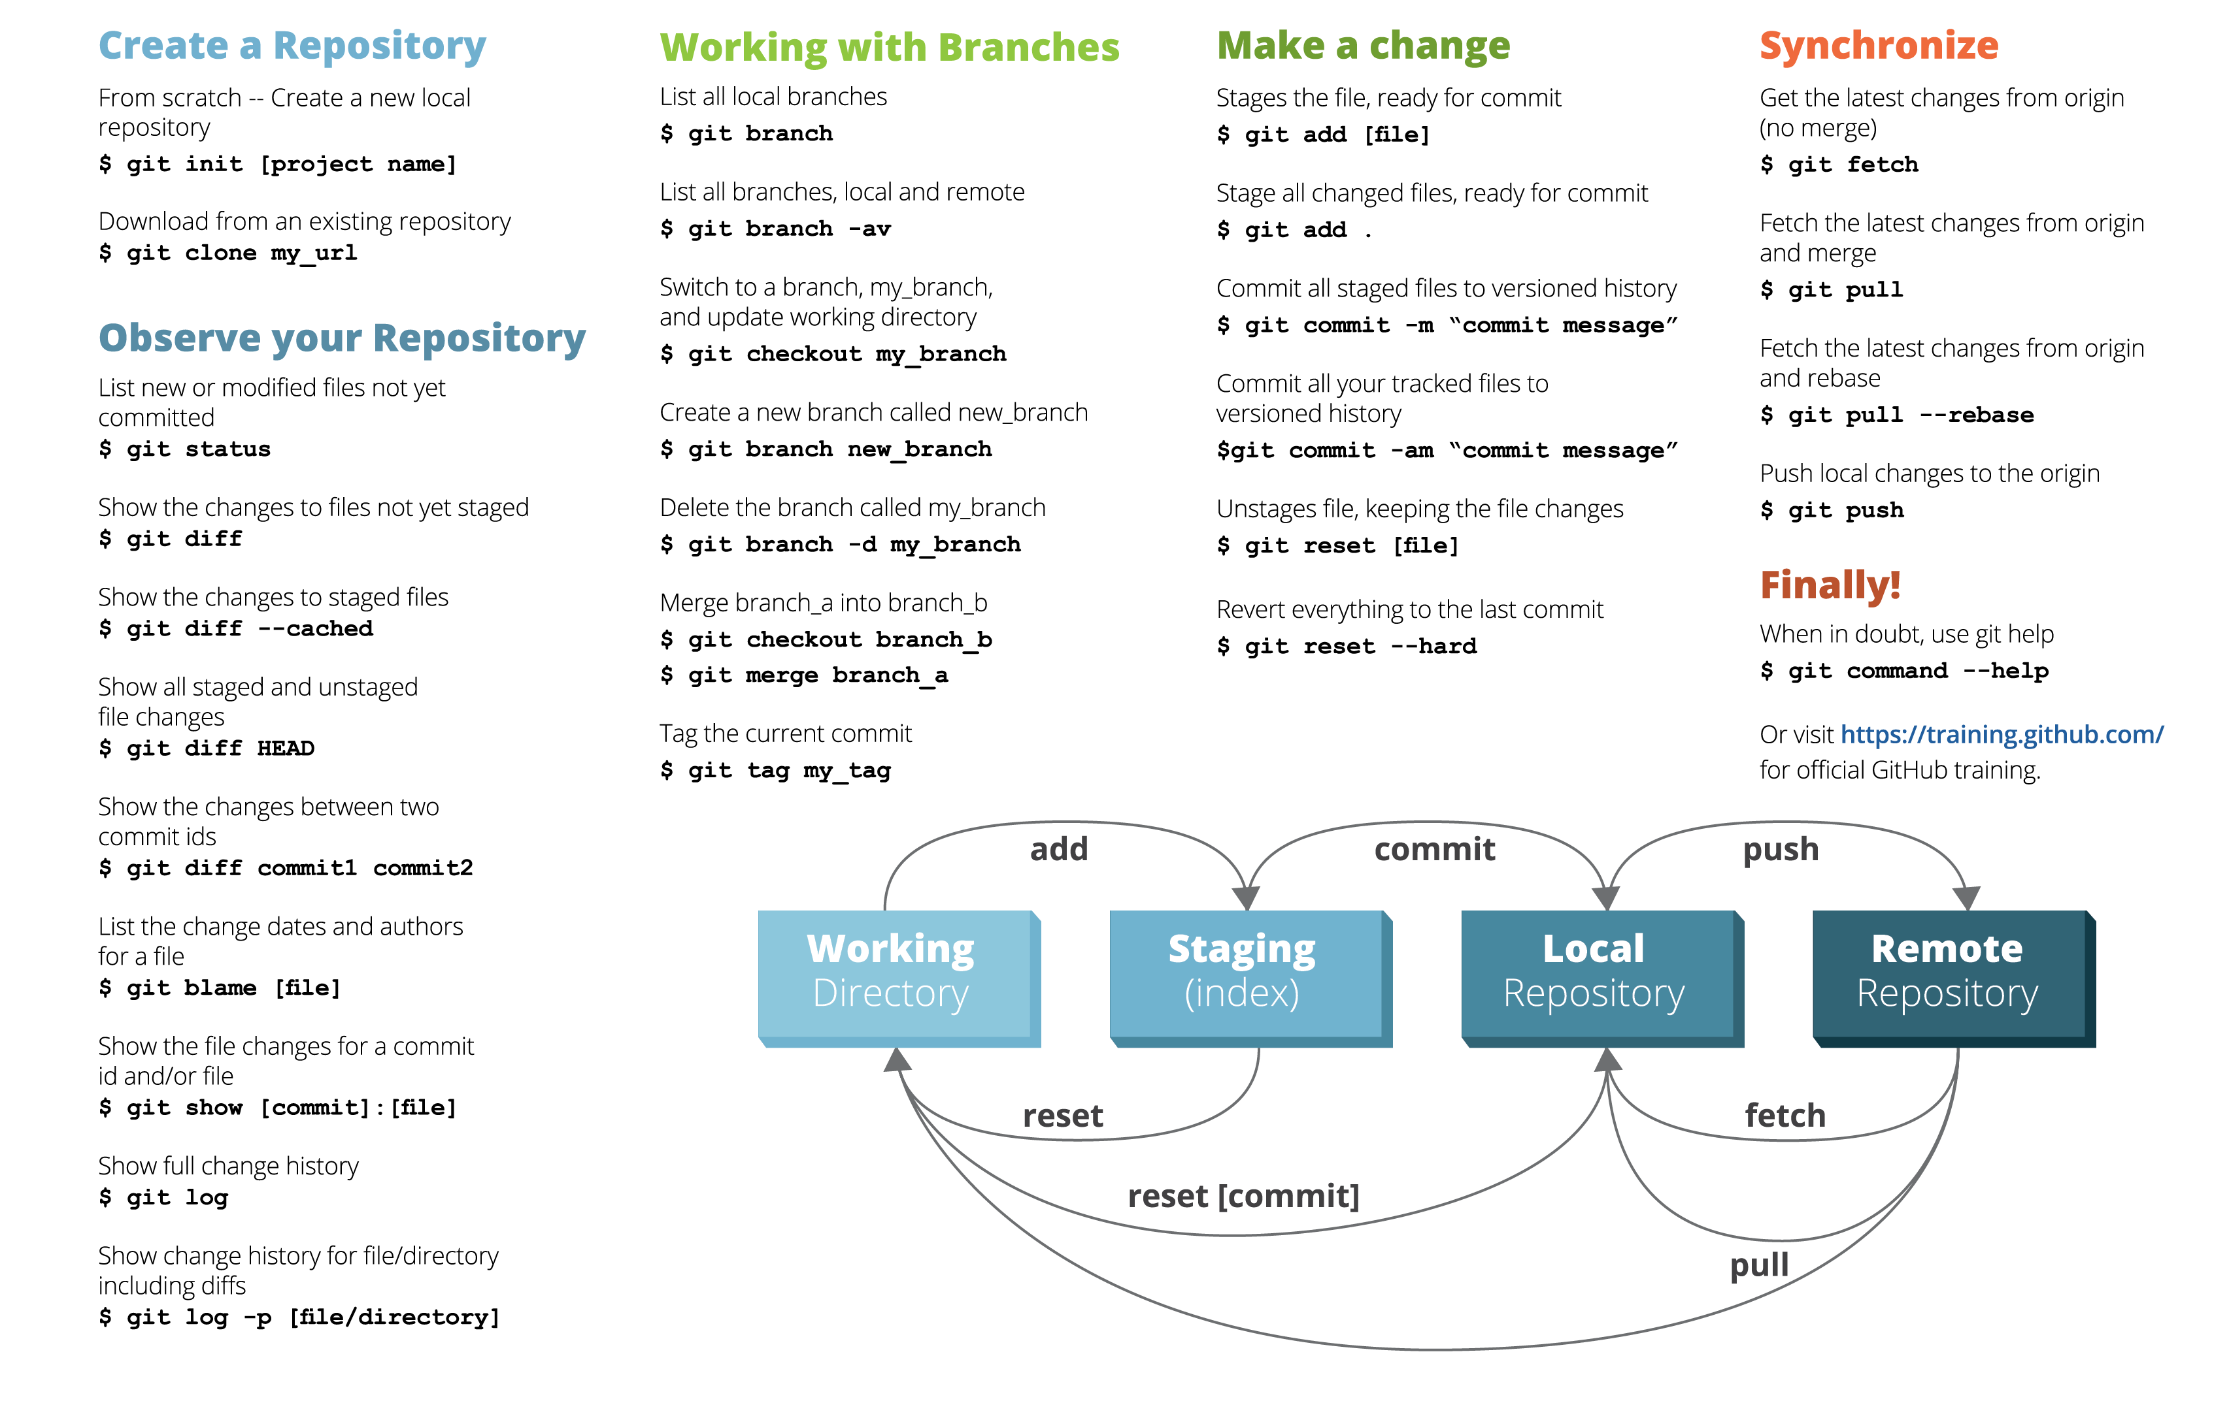
GIT Cheat Sheet

Slide 6
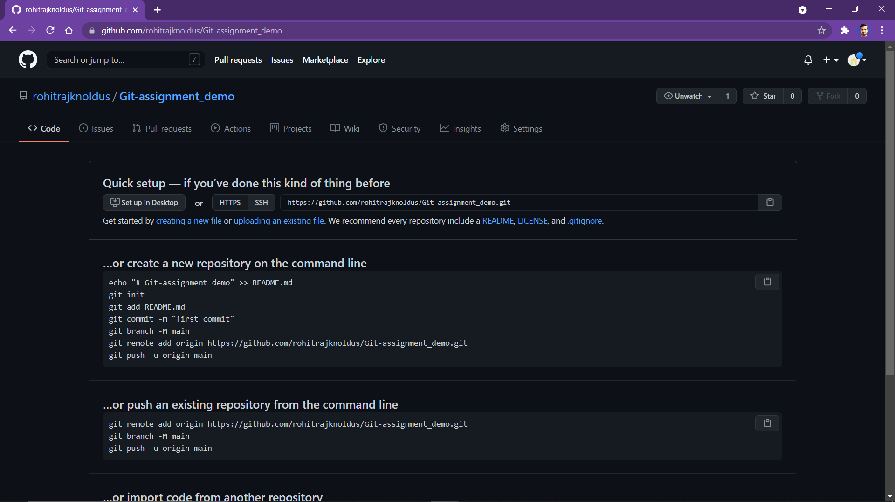
CREATING AN EMPTY REPOSITORY ON GITHUB

Slide 7
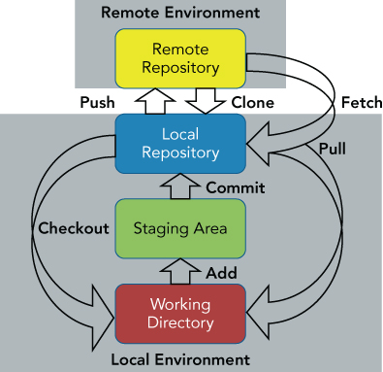

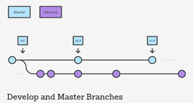
BASIC GIT WORKFLOW
A Git workflow is a recipe or recommendation for how to use Git to accomplish work in a consistent and productive manner. Git workflows encourage developers and DevOps teams to leverage Git effectively and consistently.
Git offers a lot of flexibility in how users manage changes.

Slide 8
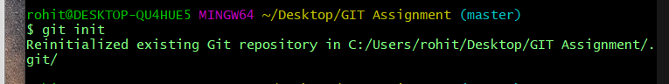

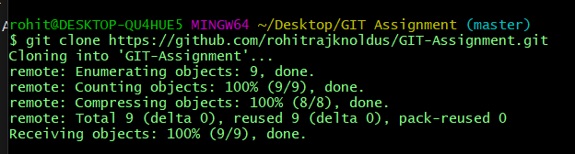

Initializing the central repository:
Clone the central repository:

Slide 9
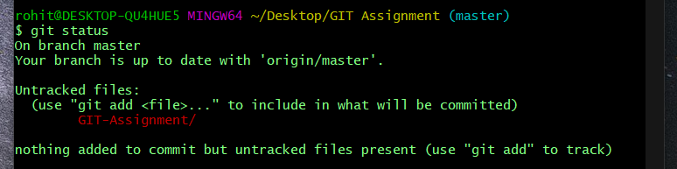
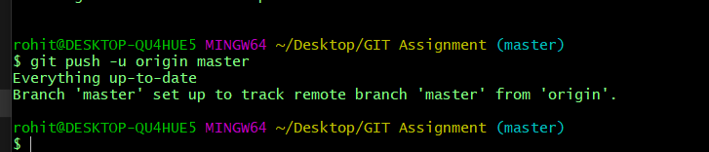
Checking Status of the Repo:
Pushing New Commit:

Slide 10
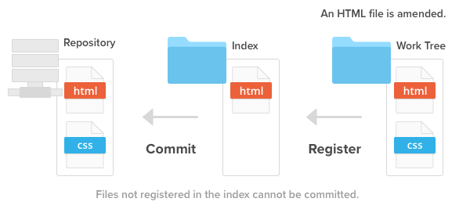
GIT WorkTree
The working tree, or working directory, consists of files that you are currently working on. You can think of a working tree as a file system where you can view and modify files.

Slide 11
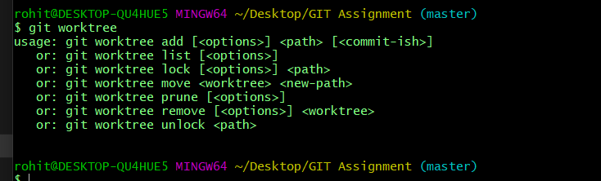
Common use of Worktree
GIT WORKTREE : It lists all Worktree in my repository

Slide 12
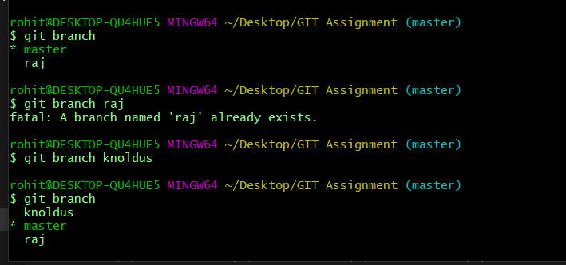
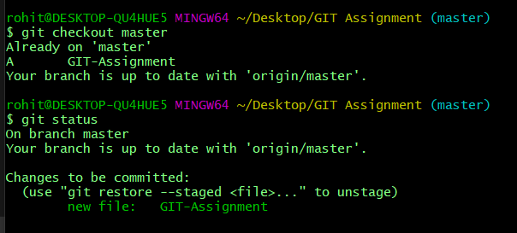
Creating a New Branch : It will Create a new branch called ＜branch＞. This does not check out the new branch.
Switching Branch : It will switch from one branch to another branch.

Slide 13
Conclusion
In conclusion, Git provides a way of keeping track of past versions of software and papers, making collaboration between various authors easy, and provides backup for your software. It has proven very useful to the open-source community and in academia as well.

Slide 14
MY GITHUB LINK -
https://github.com/rohitrajknoldus/GIT-Assignment

Slide 15

Thank You!

